Slide 1
Geospatial Correlates of Black Lives Matter Protests in Florida
Sophia Carter, Alessandra Cassiano-Salinas, Darren Colby, Pierce Wilson

Slide 2
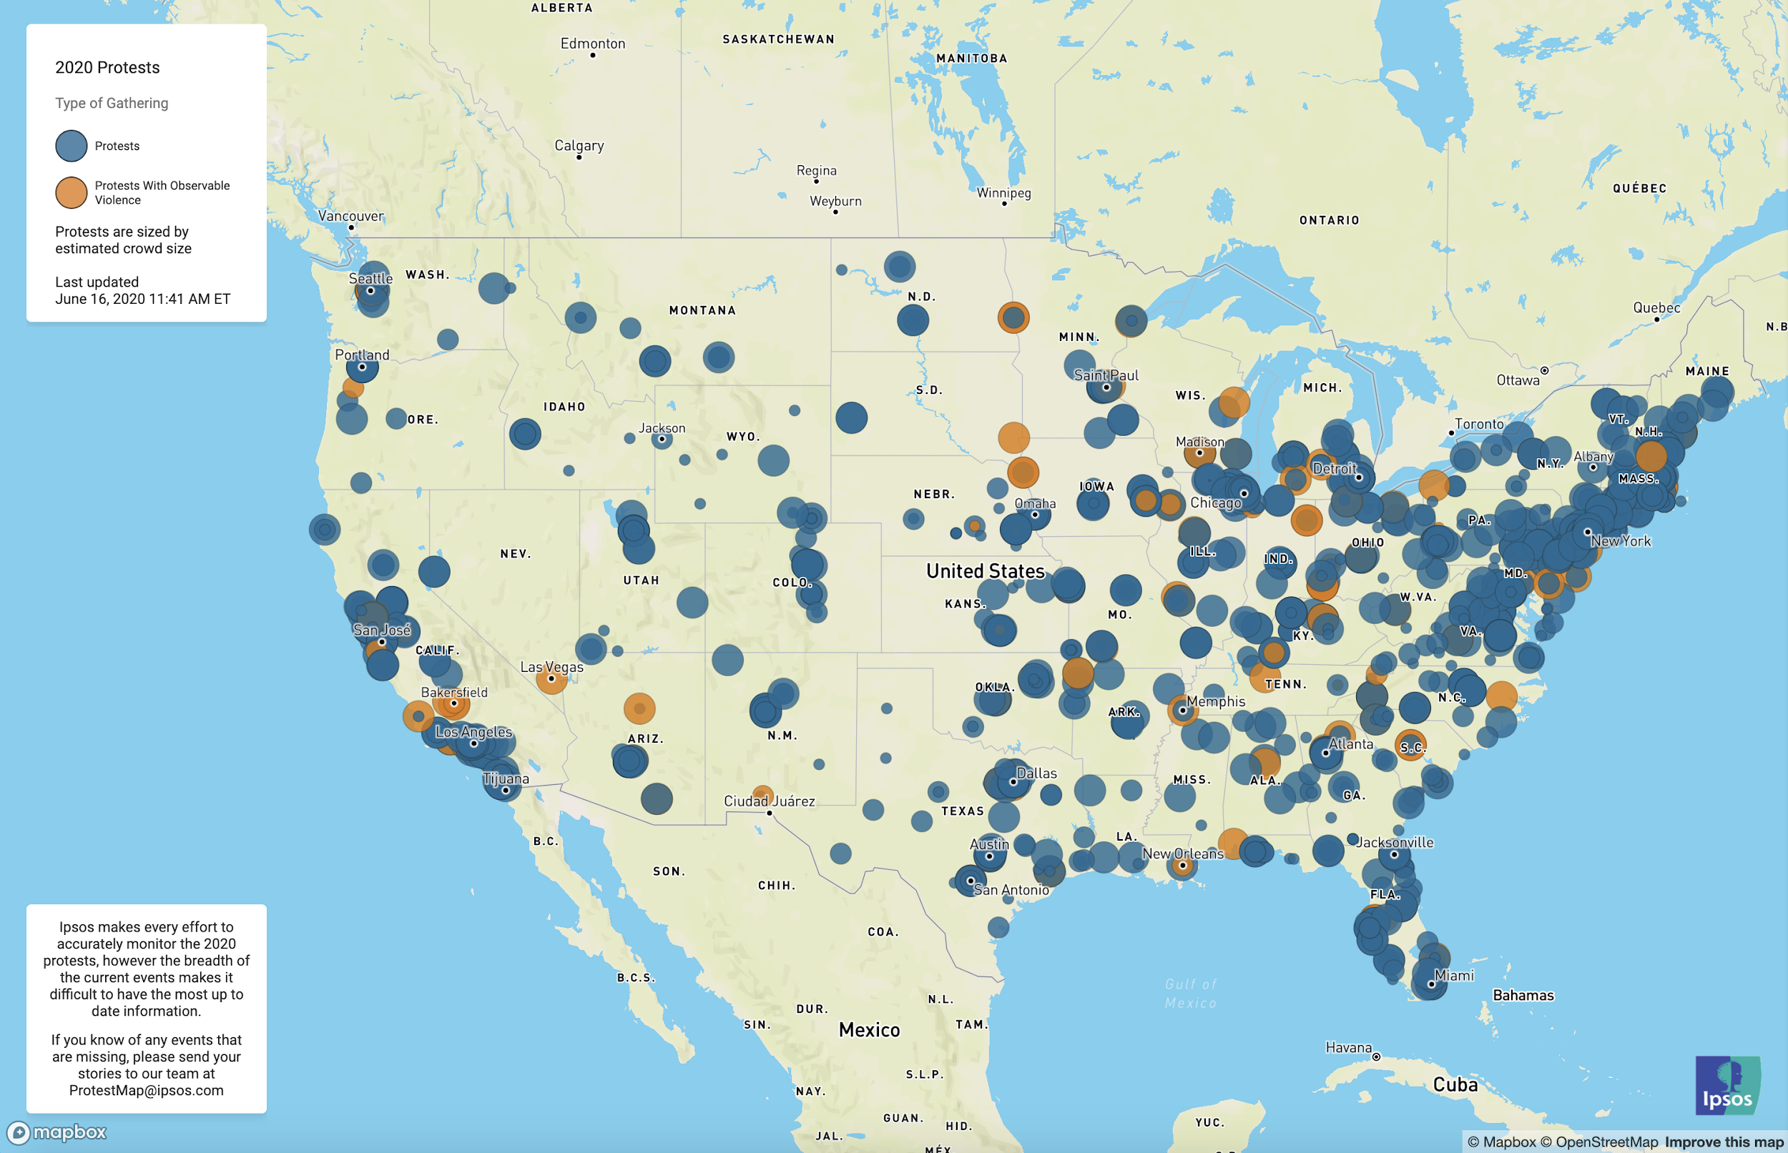
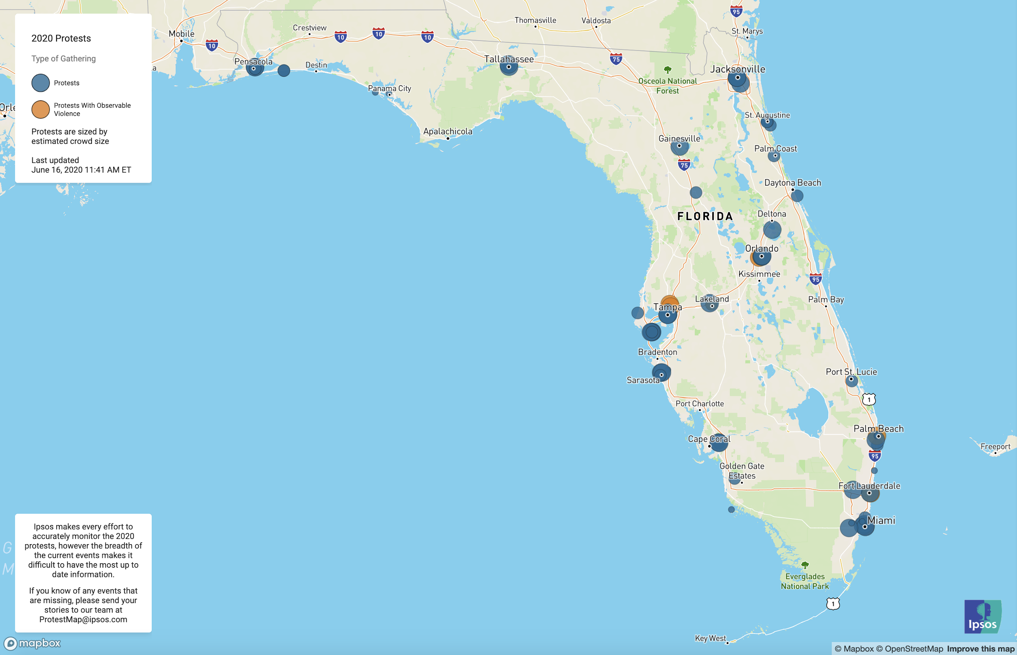

Slide 3
Project Description
Factors: Spatial distribution of…
Proximity to colleges/universities
Political affiliation
Racial (im)balance
Median household income
2020 Protests
Classify Florida census tracts (n = 4, 245) based on likelihood and number of protests
Patterns or outliers?
Hypothesis: all five demographic factors would be significant in predicting protests in each census tract
Notes:
Continuous police violence against unarmed Black folks throughout the United States, but most influentially against George Floyd, has once again brought into national conversation the role of police and policing - leading to the organization and fruition of several protests against police brutality since the spring of 2020.
Why we were interested: wanted to know what factors affect Black Lives Matter protests
Through our project, we sought to examine if and to what extent proximity to postsecondary institutions (colleges and Universities) and the spatial distributions of racial (im)balance, political party affiliation, and median household income affect the likelihood and number of protests occurring in any given census tract - with a specific focus on the State of Florida and any patterns or outliers within its data

Slide 4
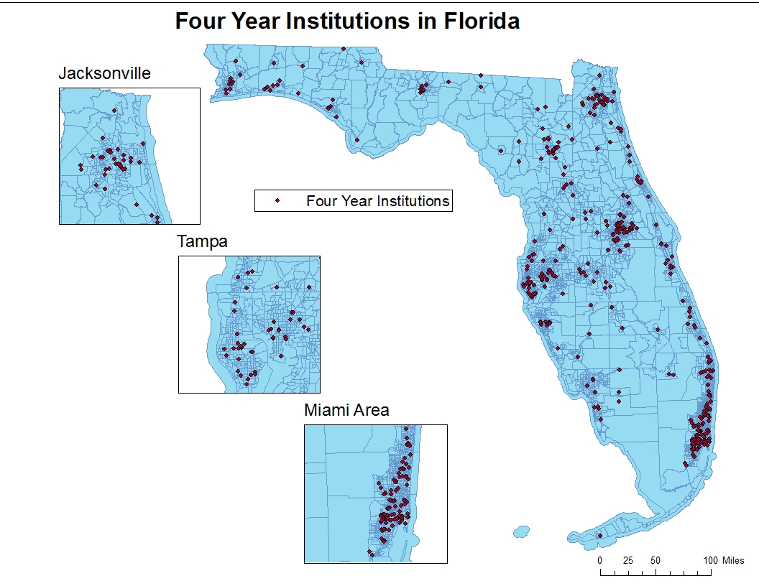
Description of Study Area

Slide 5
Description of Study Area
Notes:
Why we chose Florida:
Politically Diverse, had a lot of protests, over 400 colleges/universities, decent mix of rural and city, has one state plane system, personal familiarity
Chose these 3 cities: population dense and most interesting results in terms of political affiliation and racial homogeneity (and their relationship to each other)

Slide 6
Factors and Data
Census Tracts
Standard shapefile from the Florida Geospatial Data Library (FGDL)
Colleges/Universities in each census tract
Fit models with both dummy variables and continuous variables
Data from Educational Institutions shapefile (FGDL)
Political Affiliation
Ratio of GOP to Dem votes in 2018 primaries (United States Electoral Project)
Data broken down by electoral precincts (n = 6096)

Slide 7
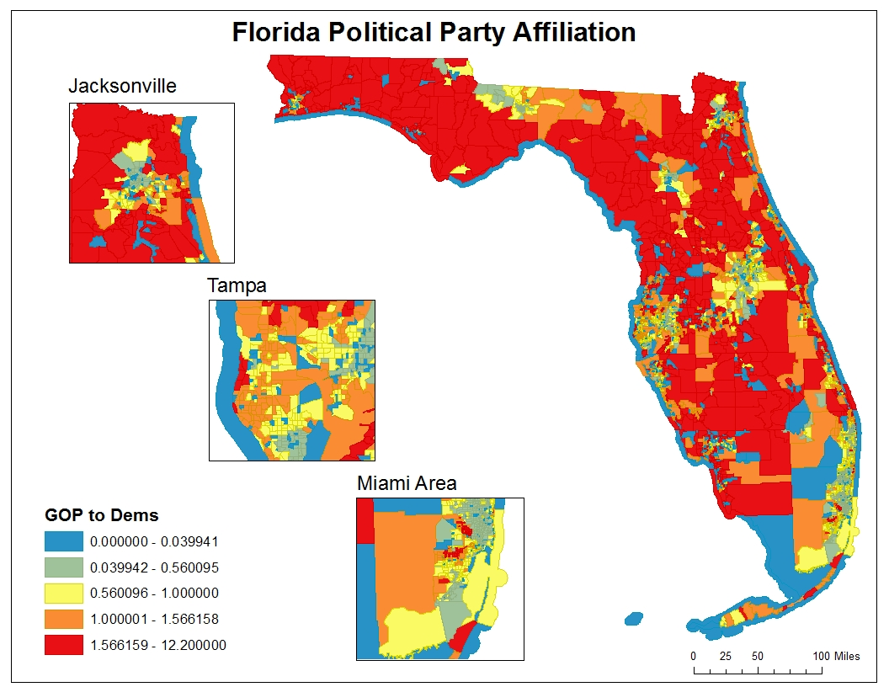
Majority Democrats
Majority Republicans
Notes:
Put on a separate slide as a placeholder, we can scale and add to previous slide or keep as separate and simplify bullet point about the map

Slide 8

Factors and Data (cont)
Racial Balance
Where B is the proportion of Black /African Americans
W is the proportion of white
N is the proportion of Native Americans
A is the proportion of Asians
P is the proportion of Pacific Islanders/other races
Where BC^i is the BC for each census tract
Wealth
Median Household Income from the U.S. Census
Protests
Protests on ArcGIS Online from the GYSTOE page

Slide 9
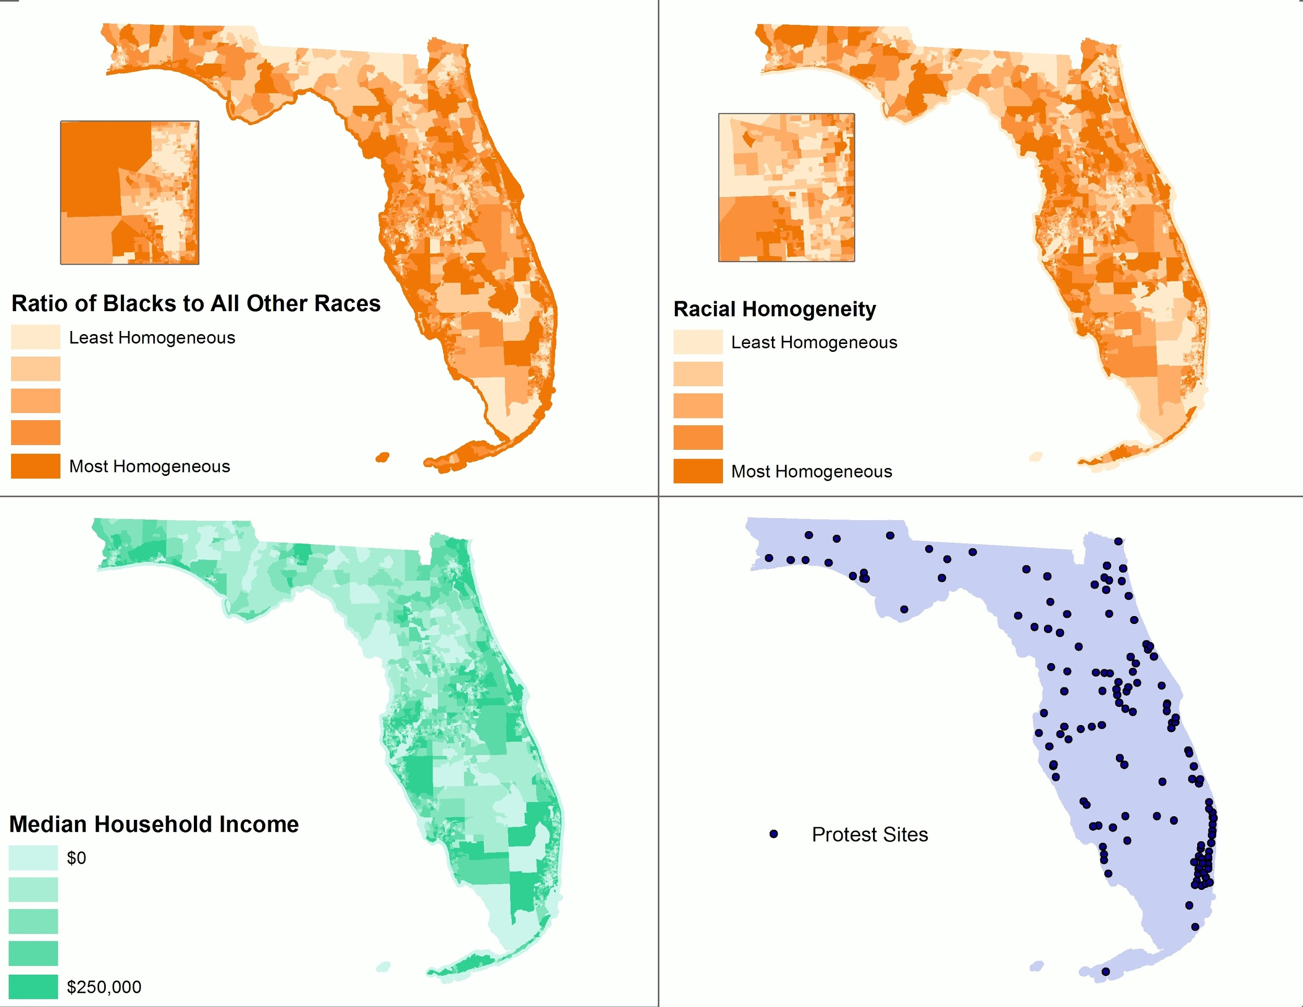
Miami Area
Miami Area
Ratio of Black Population to All Other Races

Slide 10
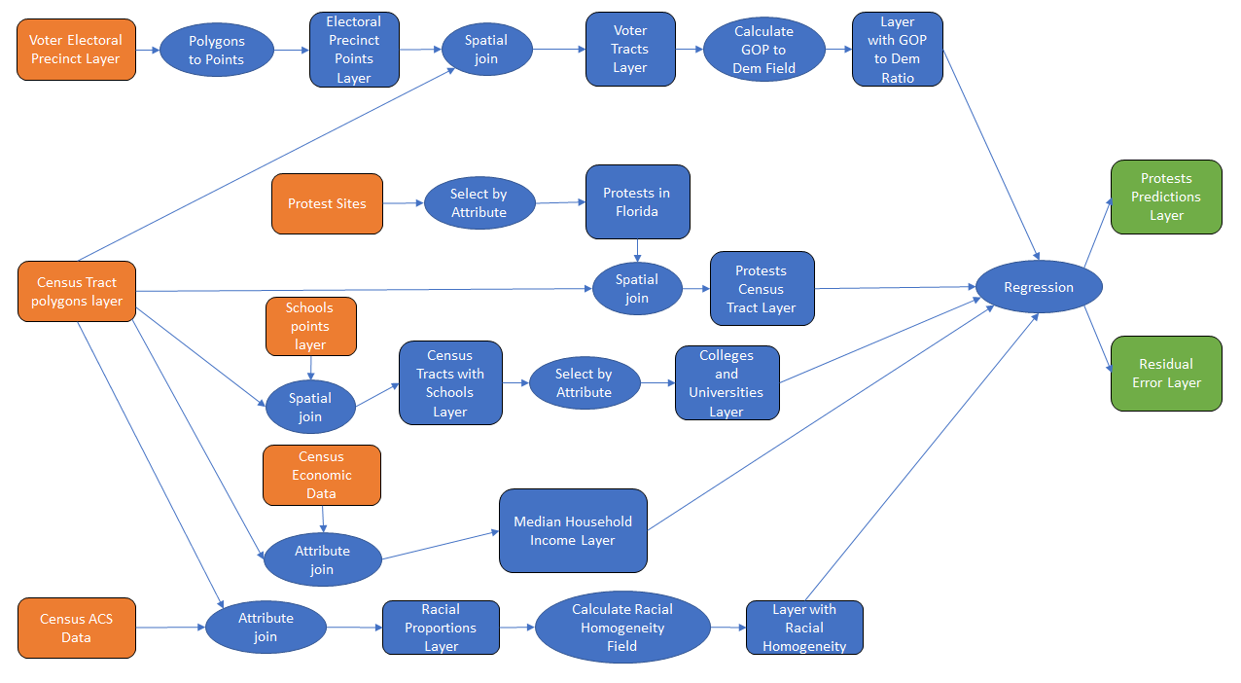

Slide 11
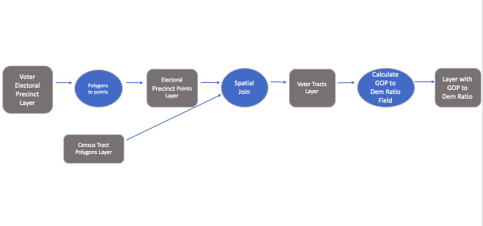

Slide 12
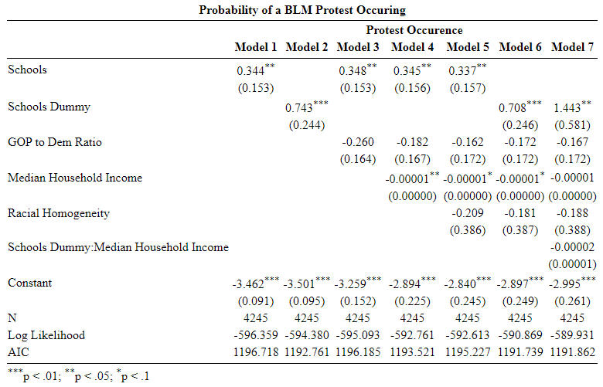
Results
Model 6 provided the best fit
Proximity to schools and median HH income are statistically significant
Both the dummy and continuous variable for schools was statistically significant
Notes:
**explain “dummy variable” earlier in the presentation

Slide 13
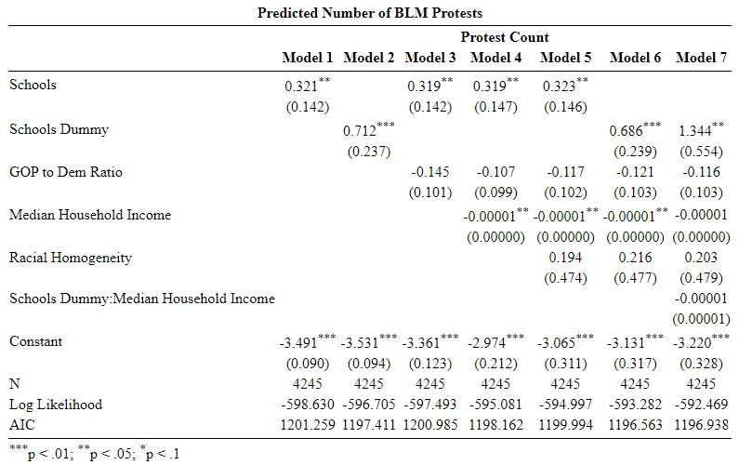
Results (cont)
Again, Model 6 fits the best
Proximity to schools and median HH income also statistically significant

Slide 14
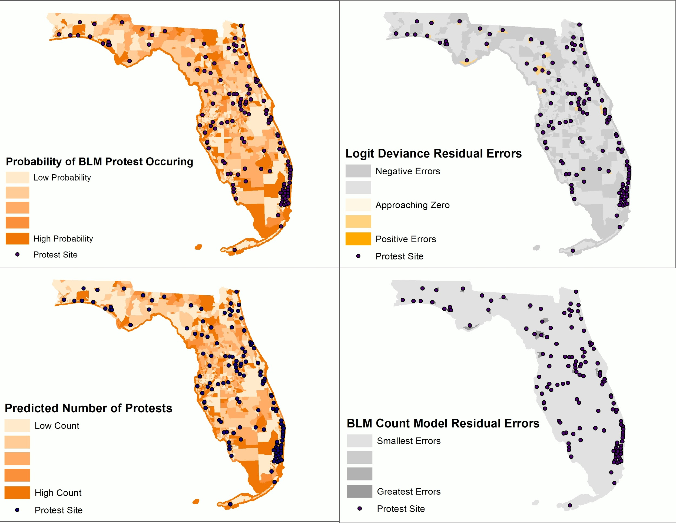
Notes:
Make sure to simplify classifications

Slide 15
Notes:
Make sure to simplify classifications

Slide 16
Majority Democrats
Majority Republicans

Slide 17
Conclusion
Proximity to colleges/universities and median household income are causal factors, racial heterogeneity and political party distribution are not.
Models more accurate for southern part of the state.
Models overestimated protests in northern tracts with high GOP concentrations.
GIS was really useful for this specific application and gave us insights that we would not have found without GIS.
Notes:
Trade offs?
Spatial joins

Slide 18
Further Research
What other factors explain BLM protests? What confounding factors impacted our findings?
Would these results hold across states?
Would an influx of students change the results?
Using municipal level data
Notes:
Pierce

Slide 19
Data Sources
U.S. Census American Community Survey
U.S. Census Selected Economic Indicators
Florida Geospatial Data Library
United States Electoral Project
GYSTOE ArcGIS Online Page

